Slide 1

UNIVERSITY INSTITUTE OF ENGINEERING
DEPARTMENT- ACADEMIC UNITS
FIRST YEAR ENGINEERING PROGRAMMES
Subject Name : Basic Data Structures using C++
Subject Code: 24CSH-103
QUEUE
DISCOVER . LEARN . EMPOWER

Slide 2


Basic Data Structure Using C++
Course Objectives
To enable the students to understand various stages and constructs of C++ programming language.
To improve their ability to analyze and address variety of problems in C++.
To understand the concept of data structures and various operations on them.
To understand the properties of various data structures and able to identify the strengths and weaknesses of different data structures.
To analyze and compare the efficiency of algorithms and learn to design efficient algorithms for solving computing problems

Slide 3


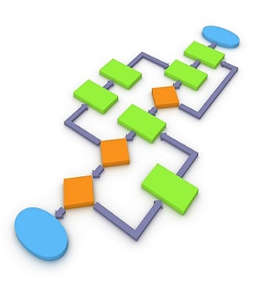
Course Outcomes
CO Number | Course Outcome
CO1 | Understand the concepts of object-oriented programming including programming process and compilation process.
CO2 | Apply different techniques to decompose a problem and programmed a solution with various concepts of object-oriented programming language.
CO3 | Analyse and explain the behaviour of linear data structure operations using the programming addressed in the course.
CO4 | Implement and evaluate the programs using the syntax and semantics of object-oriented programming.
CO5 | Design the solution of real-world problems in order to determine that the program performs as expected.

Slide 4
Scheme of Evaluation
Sl No. | Direct Evaluation Instruments | Weightage of actual conduct | Frequency of Task | Final Weightage in Internal Assessment | BT Levels | CO Mapping | Mapping with SIs (ABET) | Mapping with PIs | Remarks (Graded/Non-Graded)
1 | Assignment | 10 marks for each assignment | One per unit | 10 | Hard | CO4,CO5 | SO1 | 1a,1b,1c | Graded
2 | Exam | 20 marks for one MST | 2 per semester | 20 | Medium | CO1,CO2,CO3,CO4 | SO6 | 6a,6b | Graded
3 | Case Study | 8 marks | 1 per unit | 8 | Easy | CO2 | SO1, SO6 | 1c,6b | Graded
4 | Homework | NA | One per lecture topic (of 2 questions) | NA | NA | NA | NA | NA | Non-Graded
5 | Discussion Forum | NA | One per unit | NA | NA | NA | NA | NA | Non-Graded
6 | Presentation | NA | NA | NA | NA | NA | NA | NA | Non-Graded
7 | Attendance | NA | NA | 2 | NA | NA | NA | NA | Graded
S No. | Direct Evaluation Instruments | Weightage of actual conduct | Frequency of Task | Final Weightage in Internal Assessment | BT Levels | CO Mapping | Mapping with SIs (ABET) | Mapping with PIs | Remarks (Graded/Non-Graded)
1 | Unit wise Practical Evaluation | 15 marks | 3 | 45 | Medium | 1,2,3,4,5 | 1a, 1b, 1c, 6a, 6b | SO1, SO6 | Graded
2 | Exam | 15 marks for one MST | 1 per semester | 15 | Medium | 1,2,3 | 1a, 1b, 1c, 6a, 6b | SO1, SO6 | Graded
3 | Attendance | NA | NA | 2 | NA | NA | NA | NA | Graded

Slide 5
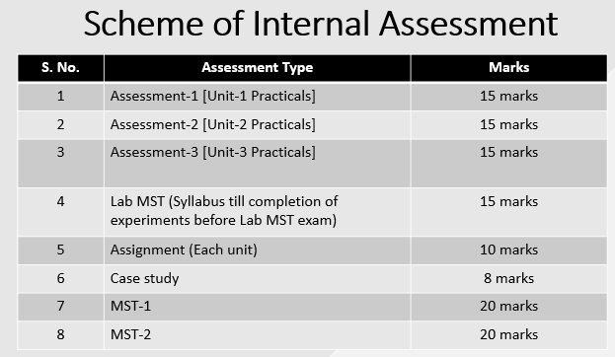
ASSESSMENT PATTERN
The performance of students is evaluated as follows:
 | Theory |  | Practical
Components | Continuous Internal Assessment (CAE) | Semester End Examination (SEE) | Continuous Internal Assessment (CAE) | Semester End Examination (SEE)
Marks | 40 | 60 | 60 | 40
Total Marks | 100 |  | 100

Slide 6
Queues
Like a stack, a queue is also a list. However, with a queue, insertion is done at one end, while deletion is performed at the other end.
-- The insertion end is called rear
-- The deletion end is called front
Remove
Insert
front
rear

Slide 7

Queues
A queue is a data structure that stores data in such a way that the last piece of data stored, is the last one retrieved. It is also called First-In, First-Out (FIFO).
Consider people standing in line. They get service in the order they arrive.
A Queue is "an abstract data type in which elements are added to the rear and removed from the front; a 'first in, first out' (FIFO) structure."
http://www.cs.uregina.ca/Links/class-info/210/Queue/

Slide 8
Queues
A Queue is a linear list of elements in which deletions can take place only at one end, called the front, and insertions can take place only at the other end, called the rear. The terms “front” and “rear” are used in describing a linear list only when it is implemented as a queue.
Queues are also called first-in first-out (FIFO) lists, since the first element in a queue will be the first element out of the queue. In other words, the order in which elements enter a queue is the order in which they leave. This contrasts with stacks, which are Last-in First-out (LIFO) lists.

Slide 9
Queue in everyday life
The automobiles waiting to pass through an intersection form a queue, in which the first car in line is the first car through.
The people waiting in line at a bank form a queue, where the first person in line is the first person to exit from the queue.
An important example of a queue in computer science occurs in a timesharing system, in which programs with the same priority form a queue while waiting to be executed.
Queue for printing purposes.

Slide 10
Queues
Figure (a) is a schematic diagram of a queue with 4 elements, where AAA is the front element and DDD is the rear element. Observe that the front and rear elements of the queue are also, respectively, the first and last elements of the list. Suppose an element is deleted from the queue. Then it must be AAA. This yields the queue in figure (b), where BBB is now the front element. Next, suppose EEE is added to the queue and then FFF is now the rear element. Now suppose another element is deleted from the queue; then it must be BBB, to yield the queue in figure (d). And so on. Observe that in such a data structure, EEE will be deleted before FFF because it has been placed in the queue before FFF. However, EEE will have to wait until CCC and DDD are deleted.
LINKED REPRESENTATION OF QUEUE:
(a)
AAA
BBB
CCC
DDD
(b)
BBB
CCC
DDD
(c)
BBB
CCC
DDD
EEE
FFF
(d)
CCC
DDD
EEE
FFF

Slide 11
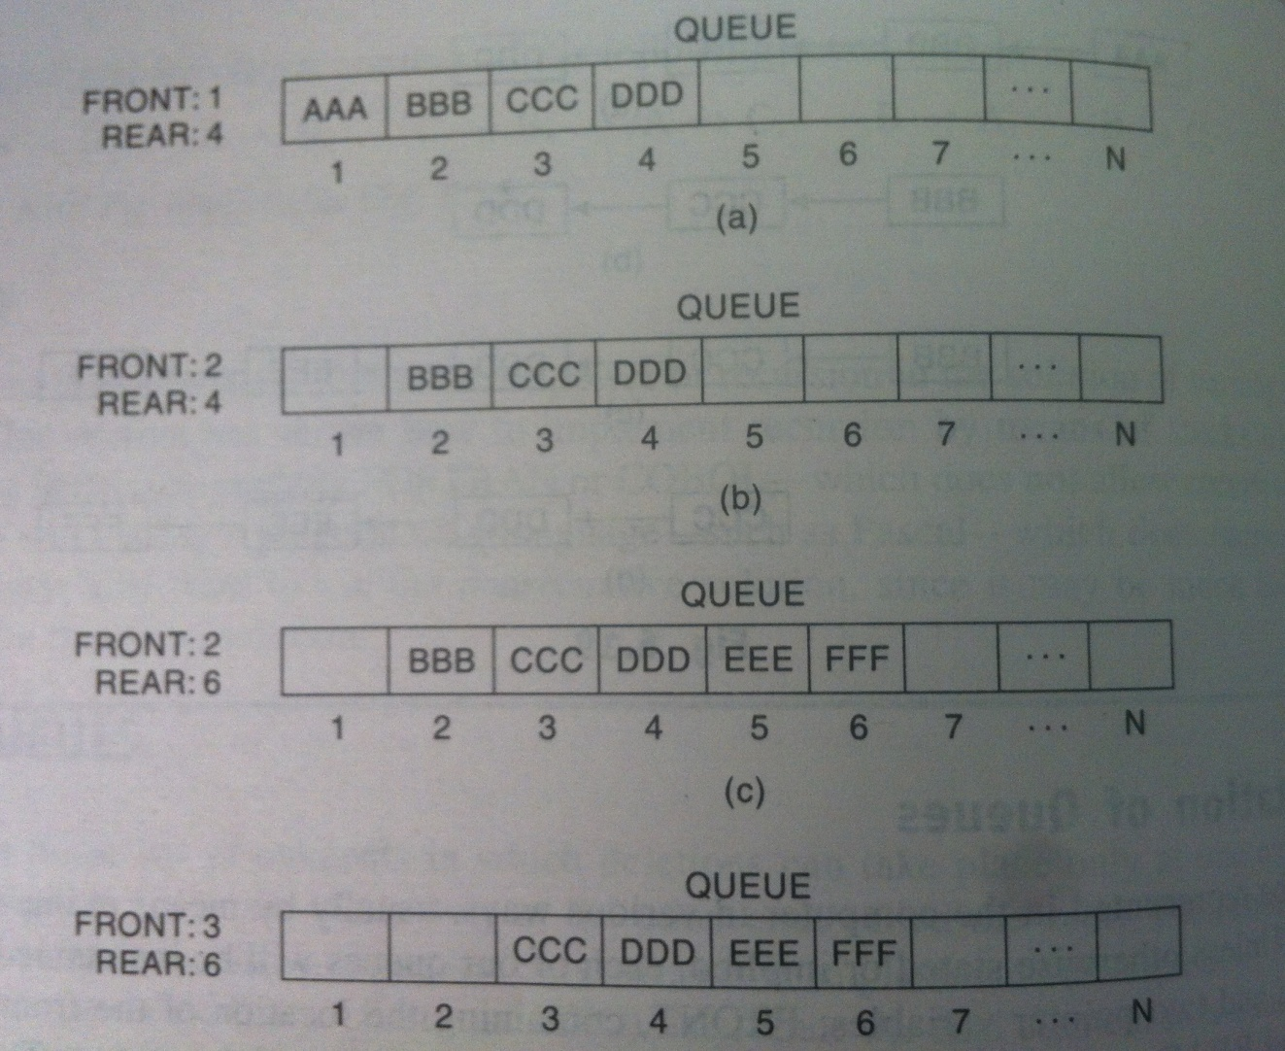
Array/Sequential representation of queue
→ When an element is deleted from the queue, the value of FRONT is increased by 1; this can be implemented by the assignment
FRONT := FRONT + 1
→Similarly, whenever an element is added to the queue, the value of REAR is increased by 1; this can be implemented by the assignment
REAR := REAR + 1

Slide 12
Queues
Enque
operation to place a new item at the tail of the queue
Dequeue
operation to remove the next item from the head of the queue

Slide 13
Queue
start
end
X
A
M
enqueue(F)
start
end
start
end
X
A
M
F
A
M
F
item = dequeue()
item = X

Slide 14
Algorithm for Insertion into a Queue
1. If REAR=MAX then: write: Overflow & Exit
2. Read ITEM
If FRONT=0 then:
a) FRONT=FRONT+1
b) REAR=REAR+1
c) Q[REAR]=ITEM
else
REAR=REAR+1
Q[REAR]=ITEM
3. Exit
QUEUE
Initially empty : FRONT : 0
REAR : 0
1 2 3 4 5
(b) A, B and then C inserted: FRONT : 1
REAR : 3
A | B | C
(C) A deleted : FRONT : 2
REAR : 3
 | B | C
(d) D and then E inserted : FRONT : 2
REAR : 5
 | B | C | D | E

Slide 15
Algorithm for deletion from a Queue
If FRONT=0 then: write: “UNDERFLOW and Exit”
If FRONT=REAR, then:
Q[FRONT]=NULL
FRONT=0
REAR=0
else
Q[FRONT]=NULL
FRONT=FRONT+1
Exit

Slide 16
Limitations of linear Queue
When an element is removed from linear queue, the location remains unused. Even if the queue is empty, new elements cannot be inserted. To avoid this, consider queue as a circle, having the last element immediately following the first element.

Slide 17
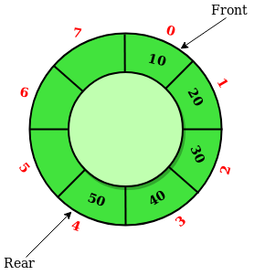
Circular Queue
Circular queue is a linear data structure in which the operations are performed based on FIFO (First In First Out) principle and the last position is connected back to the first position to make a circle. It is also called ‘Ring Buffer’.

Slide 18
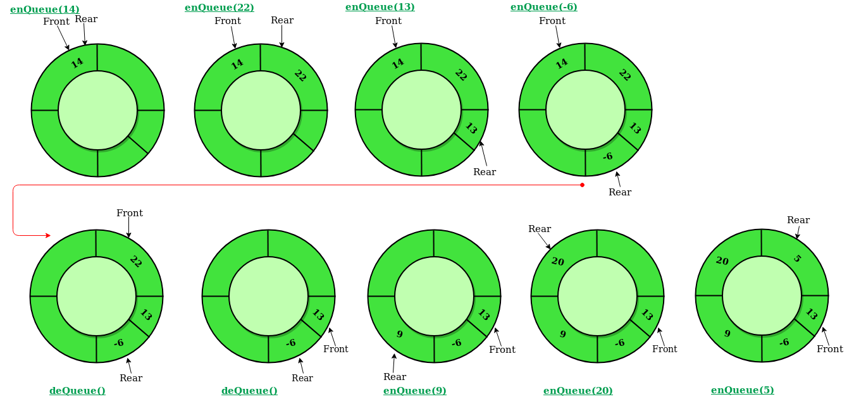
In a normal Queue, we can insert elements until queue becomes full. But once queue becomes full, we can not insert the next element. Where as in circular queue space of deleted elements can be utilized.

Slide 19
Operations on Circular Queue:
Front: Get the front item from queue.
Rear: Get the last item from queue.
enQueue(value) This function is used to insert an element into the circular queue. In a circular queue, the new element is always inserted at Rear position.
[Queue already fill]
If FRONT=1 and REAR=N, or if FRONT=REAR+1, then : Write: Overflow, and Exit.
[Find new value of REAR]
If FRONT=NULL, then :[Queue initially empty]
Set FRONT:=1 and REAR:=1
Else if REAR =N then
Set REAR:=1
Else Set REAR:=REAR+1
[End of if structure]
3. Set QUEUE[REAR]:=ITEM [This inserts new element]
4. Exit.

Slide 20
deQueue() This function is used to delete an element from the circular queue. In a circular queue, the element is always deleted from front position.
1. [Queue already empty]
If FRONT=NULL, then Write: Underflow, and Exit.
Set ITEM=QUEUE[FRONT]
[Find new value of FRONT]
If FRONT=REAR, then [Queue has only one element to start]
Set FRONT=NULL and REAR=NULL
Else if FRONT =N then
Set FRONT =1
Else
Set FRONT = FRONT +1
[End of if structure]
4. Exit

Slide 21
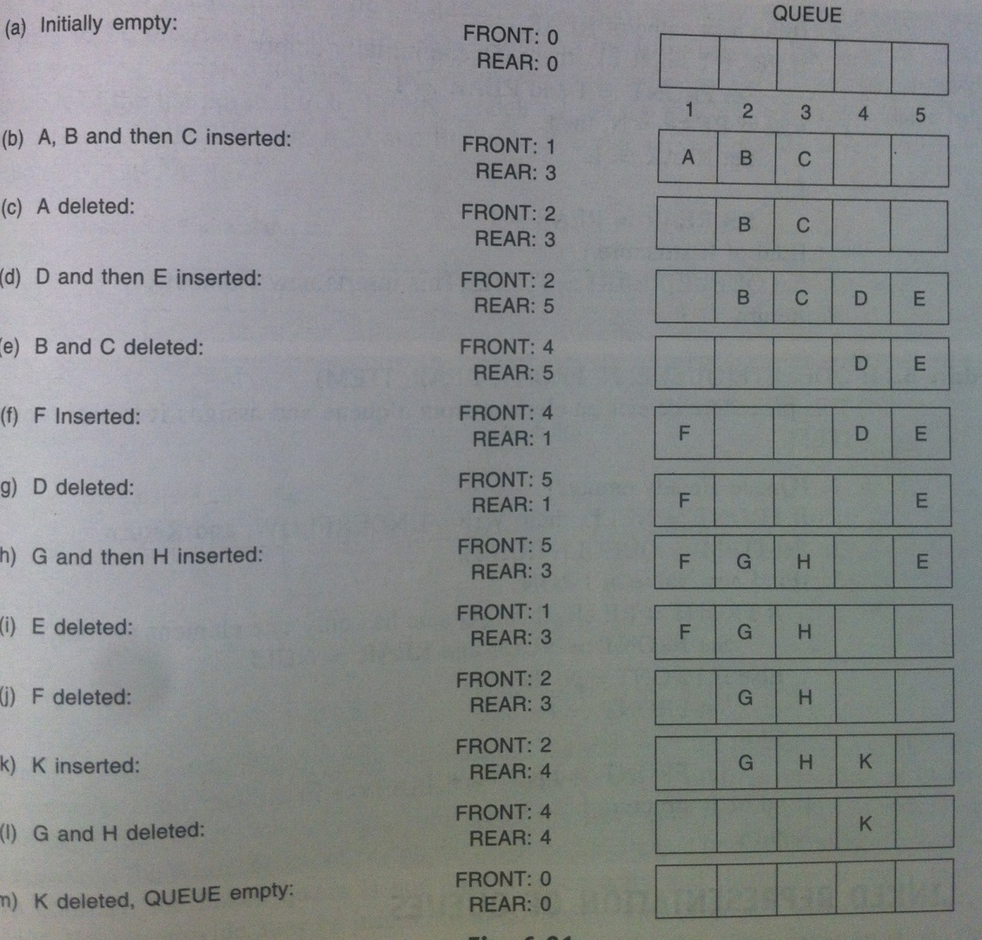
EXAMPLE: Insertion & Deletion in a circular queue

Slide 22
Advantages of circular queue over linear queue
In circular queue, the memory of the deleted process can be used by some other new process.
Rear insertion is denied in a linear queue even if the room is available. Thus, even if the free memory is available, we cannot access these memory locations. This is the major disadvantage of linear queue which is overcome by circular queue.
Time Complexity: Time complexity of enQueue(), deQueue() operation is O(1) as there is no loop in any of the operation.

Slide 23
Applications of Queue
Resource sharing among multiple consumers.
Queues are useful in time sharing systems where many user jobs will be waiting in the system queue for processing. These jobs may request the services of the CPU, main memory or external devices such as printers, etc. All these jobs will be given a fixed time for processing and are allowed to use one after the other. This is the case of an ordinary queue where priority is the same for all the jobs & whichever job is submitted first, that job will be processed.
Queues are used in designing CPU schedulers where jobs are dispatched to the CPU based on priority of the job.

Slide 24
REFERENCES
https://www.cs.cmu.edu/~adamchik/15-121/lectures/Stacks%20and%20Queues/Stacks%20and%20Queues.html
Data Structures with C/ schaum outline series/ volume 2
https://www.geeksforgeeks.org/stack-data-structure-introduction-program/
https://www.geeksforgeeks.org/queue-set-1introduction-and-array-implementation/
http://www.yashcode.com/2017/11/prefix-to-postfix-conversion-using-stack.html
Lipschutz, Seymour, “Data Structures”, Schaum's Outline Series, Tata McGraw Hill.
Gilberg/Forouzan,” Data Structure with C ,Cengage Learning.
Augenstein,Moshe J , Tanenbaum, Aaron M, “Data Structures using C and C++”, Prentice Hall of India.
Goodrich, Michael T., Tamassia, Roberto, and Mount, David M., “Data Structures and Algorithms in C++”, Wiley Student Edition.
Aho, Alfred V., Ullman, Jeffrey D., Hopcroft ,John E. “Data Structures and Algorithms”, Addison Wesley

Slide 25
THANK YOU

